Slide 1
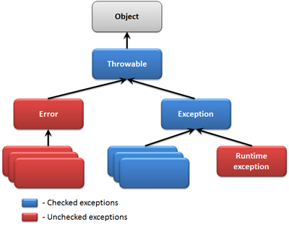
Types of Exception
Error is considered as unchecked exception.
Error is irrecoverable e.g. OutOfMemoryError, VirtualMachineError, AssertionError etc.
The classes that extend Throwable class except RuntimeException and Error are known as checked exceptions e.g.IOException, SQLException etc.
Checked exceptions are checked at compile-time.
Unchecked exceptions are the class that extends RuntimeException.
Unchecked exception are ignored at compile time. Example : ArithmeticException, NullPointerException, Array Index out of Bound exception.
Unchecked exceptions are checked at runtime.

